Slide 1
Profiling in Go
Stephen Totty
September 19, 2023

Slide 2
Profiling questions
How do we know we have performance problems?
What sort of performance problems should we investigating?
How do we know if the performance is good enough?
What if everything runs fine locally, but has problems when deployed?
What if the problem only happens at scale?
How often do we investigate performance?

Slide 3
Profiling questions
What is profiling?
In software engineering, profiling ("program profiling", "software profiling") is a form of dynamic program analysis that measures, for example, the space (memory) or time complexity of a program, the usage of particular instructions, or the frequency and duration of function calls. Most commonly, profiling information serves to aid program optimization, and more specifically, performance engineering.
Profiling is achieved by instrumenting either the program source code or its binary executable form using a tool called a profiler (or code profiler). Profilers may use a number of different techniques, such as event-based, statistical, instrumented, and simulation methods.

Slide 4
Techniques locally
Which technique you use depends on what access you have to the source code or executable.
It also depends on what tools are available.
For instance, running locally, you can use any tool you like:
Profiling during testing
Profiling with GoLand
Profiling running code by storing profiles
Profiling running code with HTTP handler
Notes:
Locally is the best place to do profiling. You have full access to the source code and any tool that you may want to use. Also, during this step, you may find some low hanging fruit that you can fix pretty quickly. Lastly, you may find the organization of your code can be optimized for benchmarking and profiling.

Slide 5
Techniques on a QA system
It gets a little trickier when running on a deployed QA system.
You don’t have direct access to the source code.
You probably have only a limited set of tools.
Even worse, it is running inside of Kubernetes!
Profiling running code by storing profiles (If you can even store them)
Profiling running code with HTTP handler
Notes:
In the QA clusters, you will have less access to tools and will only have access to the executables that are already built. You may have several storage limitations depending on your container setup. With newer Kubernetes updates now applied, we can use ephemeral debug containers.

Slide 6
Techniques on a production system
You probably cannot connect to the system at all.
You are stuck with Humio, Kiali, and Grafana!
So you need to reproduce the problem somewhere else.
Notes:
At this point, you will have no access to the physical system. This is where logging and metrics will hopefully give you enough clues to reproduce the problem elsewhere.

Slide 7
Profiling using Tests
Tests
go help test
go help testflag
func TestXXX(t *testing.T)
Use –run to run a specific test
go test -cpuprofile cpu.pprof
go test -memprofile mem.pprof
go test -blockprofile block.pprof
go test -mutexprofile mutex.pprof
go test -trace trace.out
go test -race
Notes:
You will start to see a pattern in the pprof calls, unit test calls, the Goland debug options. They all share the same underlying library calls under the covers.

Slide 8
Profiling using Benchmarks
Benchmarks
func BenchmarkXXX(b *testing.B)
All tests are run prior to benchmarks.
The testing runner executes each benchmark function several times, increasing b.N on each run until it collects a precise measurement.
go test -bench=BenchmarkXXX -cpuprofile cpuprofile.out
go test -run=^$ -bench=. | tee cpu.1
go test -run=^$ -bench=. | tee cpu.2
sudo apt install golang-golang-x-tools
benchcmp cpu.1 cpu.2
Notes:
After all the tests run, the benchmarks then will start running. Benchmarks works by calling the test code several times. You can even compare the output of two benchmark runs to see the difference in execution times.

Slide 9
Pprof and trace usage
go tool pprof -http=:8080 cpuprofile.out
go tool pprof cpuprofile.out
(pprof) help
(pprof) top
(pprof) tree
(pprof) png
(pprof) web
(pprof) quit
go tool trace traceprofile.out
Notes:
Most output is viewable running pprof. The easiest by far is using the –http option. But if you like, you can view it via the command line. Traces, are different. It has to be viewed differently using the trace tool.

Slide 10
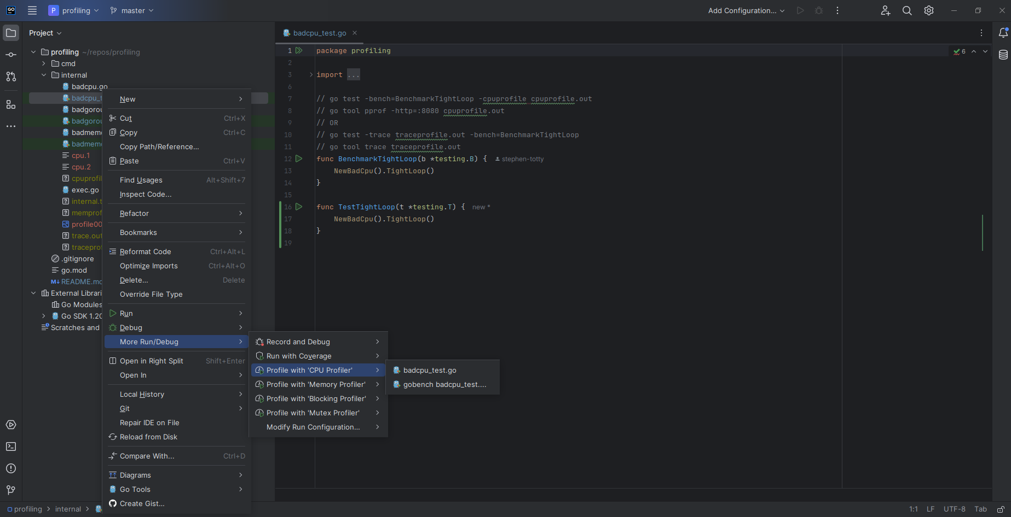
Profiling tests with Goland
Goland uses pprof under the covers
“Click on test file” -> ”More Run/Debug” -> “Profile With …”
Notes:
Goland exposes many of the same tools mentioned earlier. Maybe slightly easier to run and view the output.

Slide 11
Embedding profile creation
Profiles in "runtime/pprof“ // returns *pprof .Profile
pprof.Lookup("goroutine").WriteTo(f, 0)
pprof.Lookup("threadcreate").WriteTo(f, 0)
pprof.Lookup("heap").WriteTo(f, 0)
pprof.Lookup("allocs").WriteTo(f, 0)
pprof.Lookup("block").WriteTo(f, 0)
pprof.Lookup("mutex").WriteTo(f, 0)
Special functions in "runtime/pprof"
pprof.StartCPUProfile(f) and pprof.StopCPUProfile()
pprof.WriteHeapProfile(f)
Notes:
Many times, you wish you had a profile of something that has already run. You can embed profile creation into your executable. You can even hide the code from being executed behind flags.

Slide 12
Embedding profile creation (cont)
Special functions in "runtime"
runtime.SetMutexProfileFraction(100)
runtime.SetBlockProfileRate(100000000)
Special functions in "runtime/trace“
trace.Start(traceFile) and trace.Stop()

Slide 13
Embedding profile endpoint
_ "net/http/pprof“
Add the following code:
go func() {
log.Println(http.ListenAndServe("localhost:6060", nil))
}()
Visit http://localhost:6060/debug/pprof/
Notes:
You can also embed a webhook into your code. All of the magic happens by simply adding the import statement.

Slide 14
Resources
Go Diagnostics https://go.dev/doc/diagnostics
Profiling Go Programs https://go.dev/blog/pprof
Testing flags https://pkg.go.dev/cmd/go#hdr-Testing_flags
Runtime pprof https://pkg.go.dev/runtime/pprof
Web pprof https://pkg.go.dev/net/http/pprof
Go tools (see cmd) https://pkg.go.dev/golang.org/x/tools
Dave Cheney talk https://www.youtube.com/watch?v=nok0aYiGiYA
Dave Cheney workshop https://dave.cheney.net/high-performance-go-workshop/dotgo-paris.html
Brad Fitzpatrick (2015) https://www.youtube.com/watch?v=xxDZuPEgbBU
DataDog https://github.com/DataDog/go-profiler-notes/blob/main/guide/README.md
Goland (jetbrains) https://blog.jetbrains.com/go/2023/02/02/profiling-go-code-with-goland/
Older Goland https://blog.jetbrains.com/go/2019/04/03/profiling-go-applications-and-tests/
Infoq https://www.infoq.com/articles/debugging-go-programs-pprof-trace/
Notes:
Go provides lot of documentation on profiling. If you like videos, the Dave Cheney talk from 2019 Gophercon is highly recommended. He gives some nice nuggets about how go interacts with the native operating system. The workshop also has lots of info. Much of Brad Fitzpatrick’s 2015 talk is still very relevant.

Slide 15
My repo
Visit https://github.com/stephen-totty-hpe/profiling
Code samples
This presentation

Slide 16
Questions

Slide 17
Thank you

